Slide 1
Update 8/15/17

Slide 2
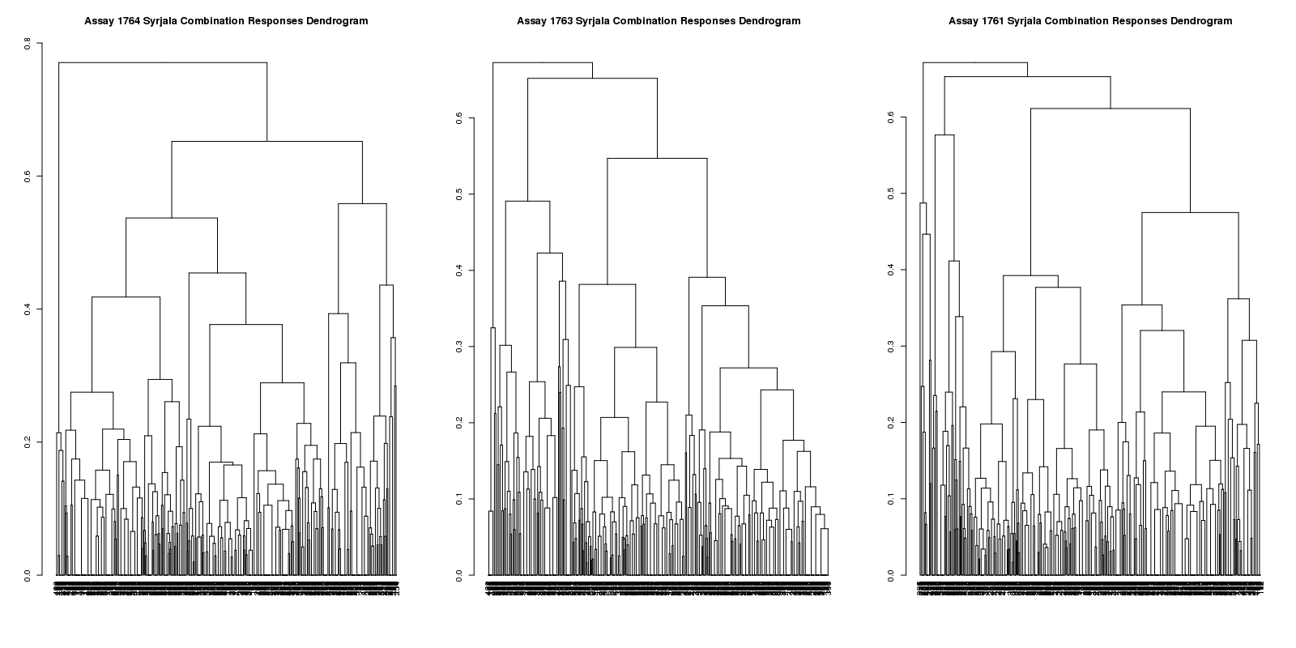
Dendrograms

Slide 3
Multidimensional Scaling
I found a way to show multidimensional scaling in R, so I did it for the matrix of dissimilarity values between the response matrices for the 3 cell lines (image on next slide)
Once I figure out the number of clusters to use, then this will be a good way to visualize where the clusters are

Slide 4
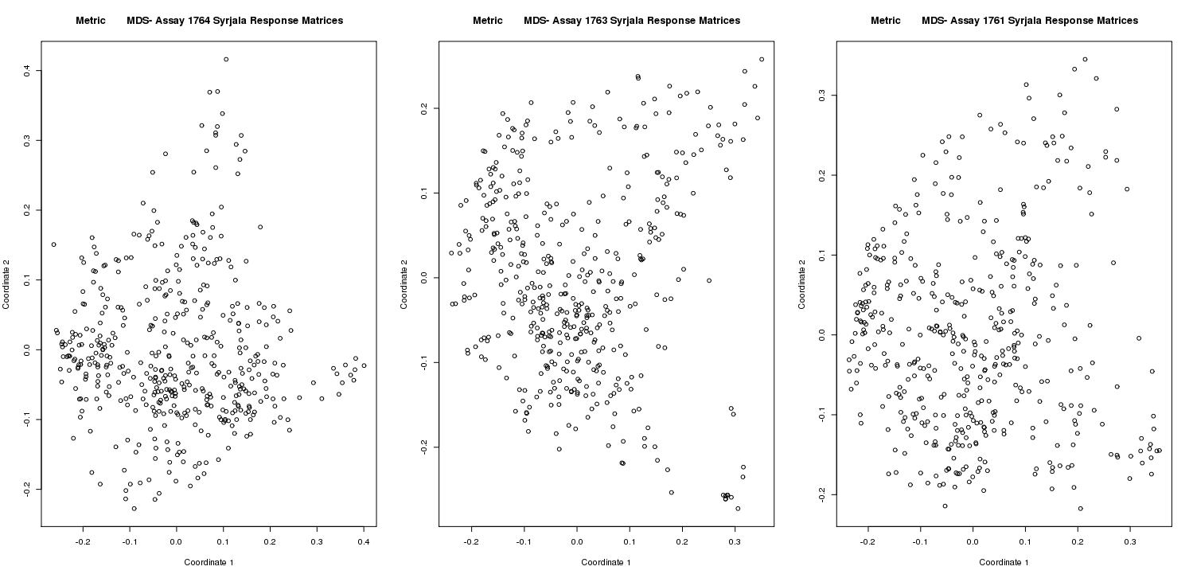
Multidimensional Scaling

Slide 5
Ways to Determine Number of Clusters
I found a couple of examples of code online (2, to be specific) to use to figure out the number of clusters to use
For this type of method, people said to look for the “elbow” of the graph-
It looks for all 3 of the malaria assays, we should use 4-6 ish clusters– thinking of just going with 5 (graphs on next slide)

Slide 6
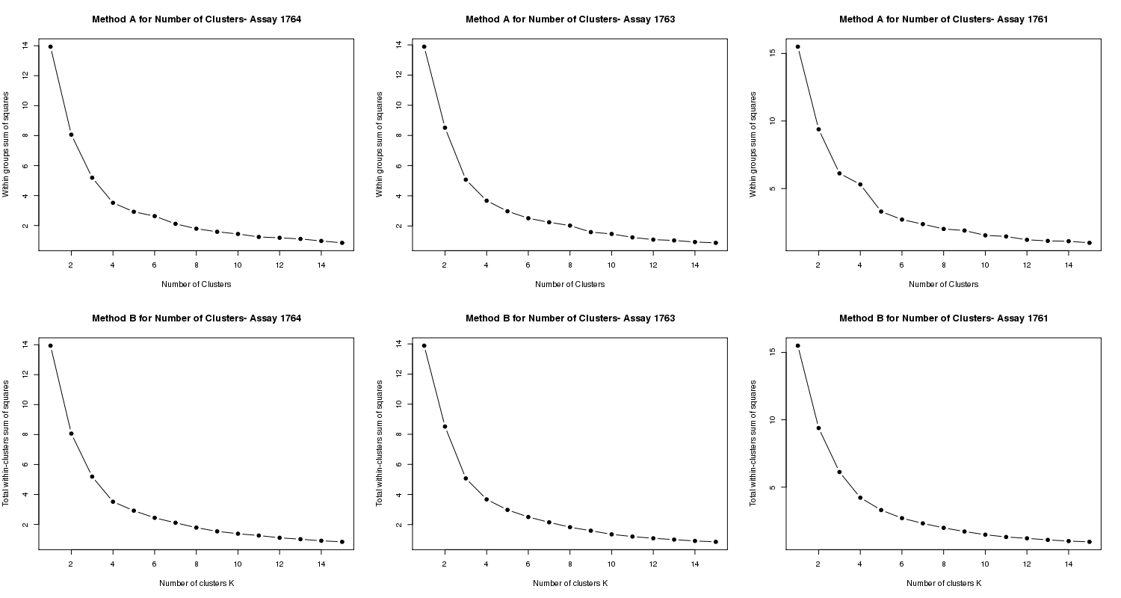
Ways to Determine Number of Clusters

Slide 7
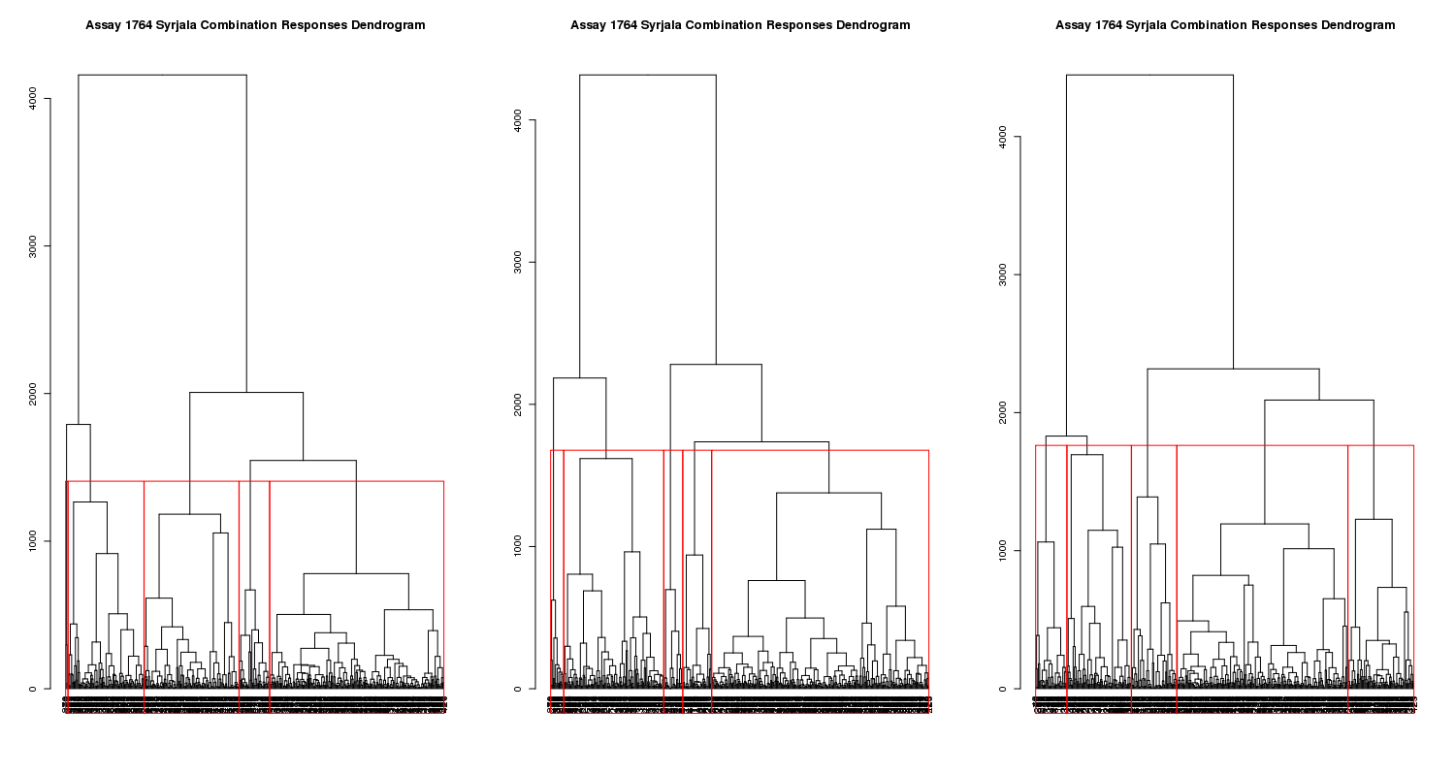
Dendrograms- 5 clusters

